Slide 1


Supporting teachers and school leaders by strengthening their interest in the profession through the entire arc of their career.

Slide 2











Notes:
PDK International is made up of several divisions and programs, including our PDK Association, Pi Lambda Theta Honors Society, The Kappan Magazine, the PDK Poll, and our scholarships and travel programs. Together, we provide a continuum of service and support for pre-teachers in our Educators Rising CTSO through teaching and those who rise into leadership positions.

Slide 3

Core Values
Community
Service
Excellence
Optimism
Leadership
Notes:
The Core Values of our organization were established in October 2024 by our board in concert with a new strategic plan. Tied to this is our vision and mission. Our vision is to eliminate the teacher shortage by reimagining educator pathways; our mission, is what we do on a day to day basis, is to inspire and grow current and rising educators to become community leaders and advocates for high quality education. As a member of our organization, you should experience these core values in your interactions with us.

Slide 4
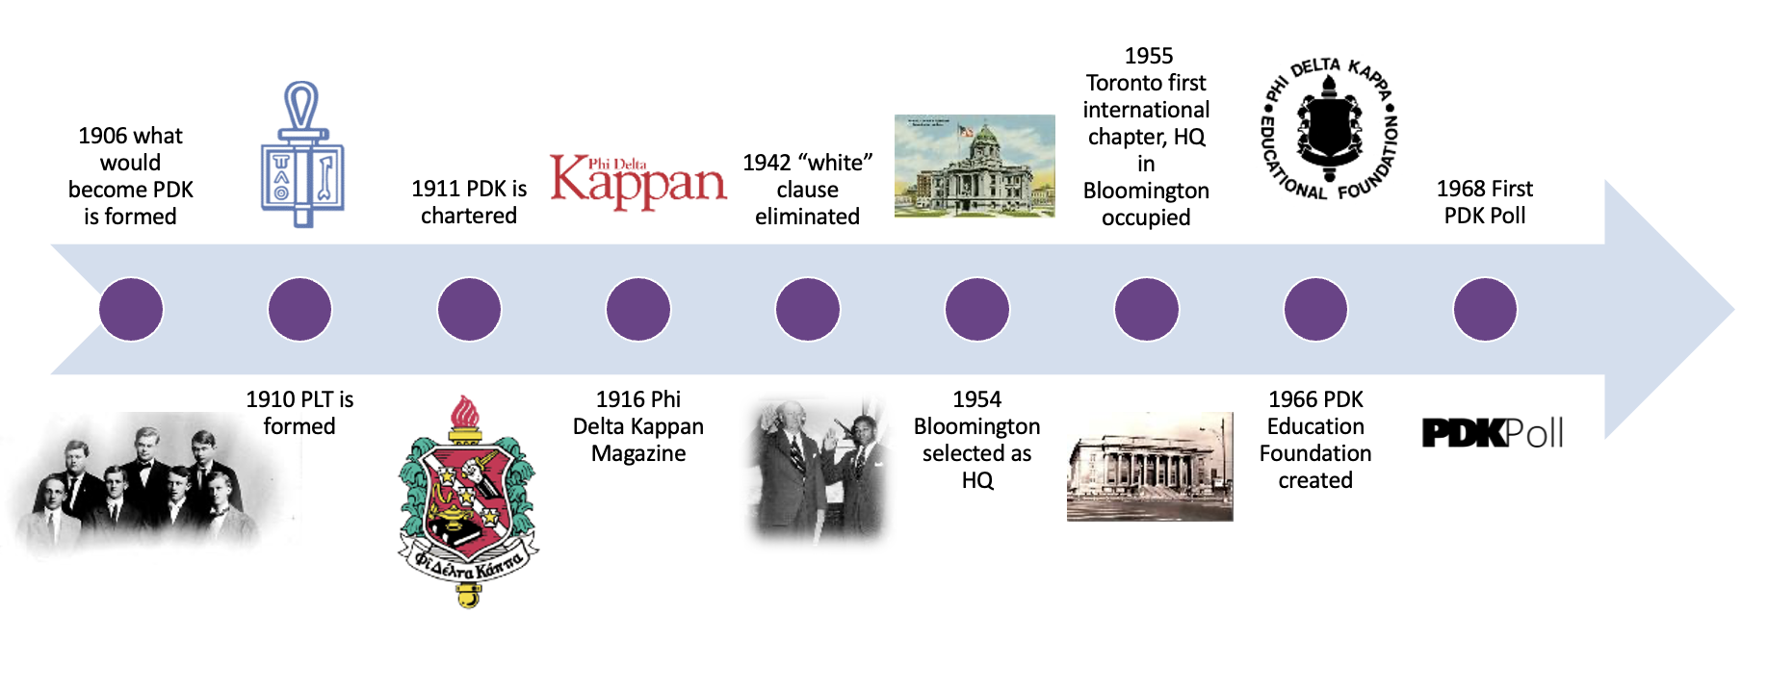
Early History
Notes:
We were established in 1906; the Kappan emerged in 1916! And in 1968 we started the PDK Poll with Gallup.

Slide 5
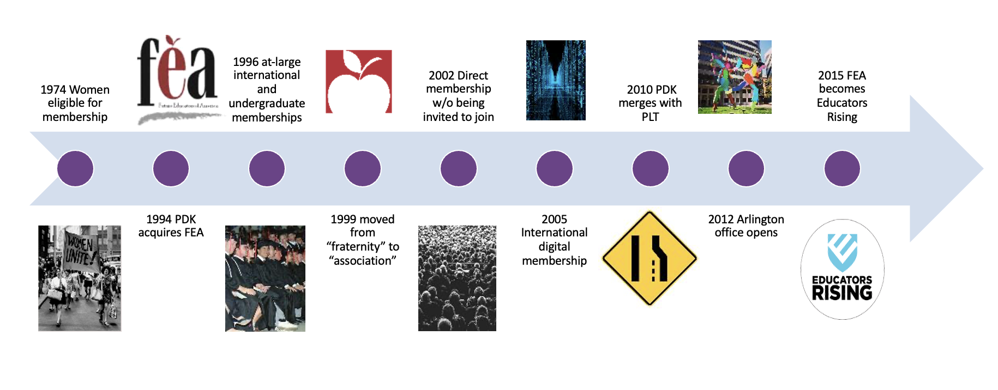
Recent Past
Notes:
More recently we acquired the Future Educators Association in 1994, and rebranded that as Educators Rising in 2015 alongside a significant investment in the CTSO. In 2010 we merged with PLT.

Slide 6
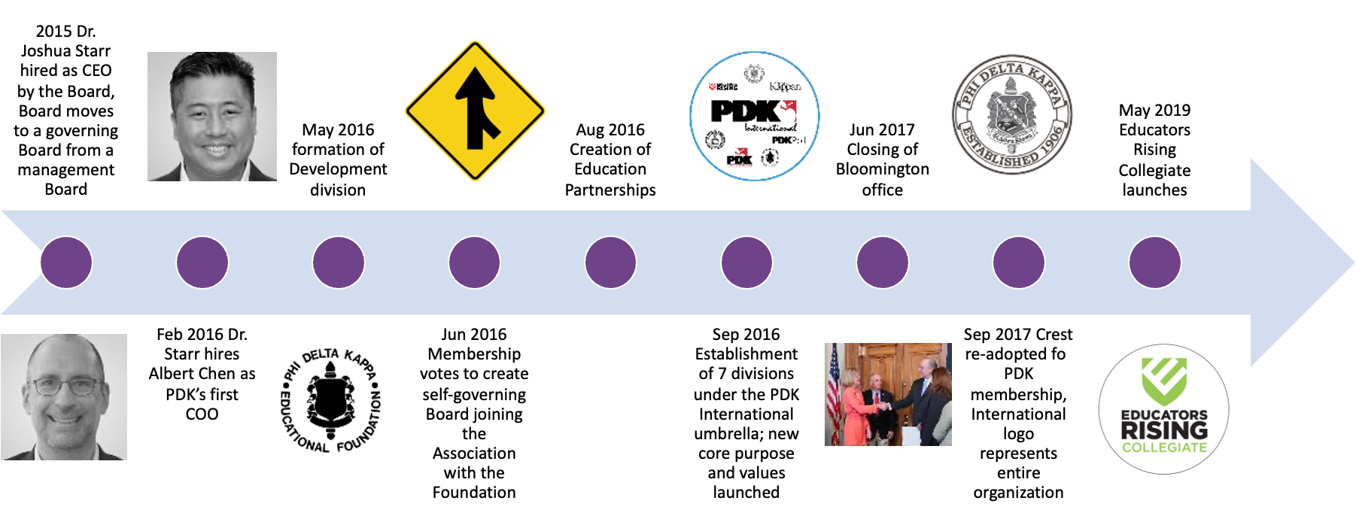
And even more recently…

Slide 7
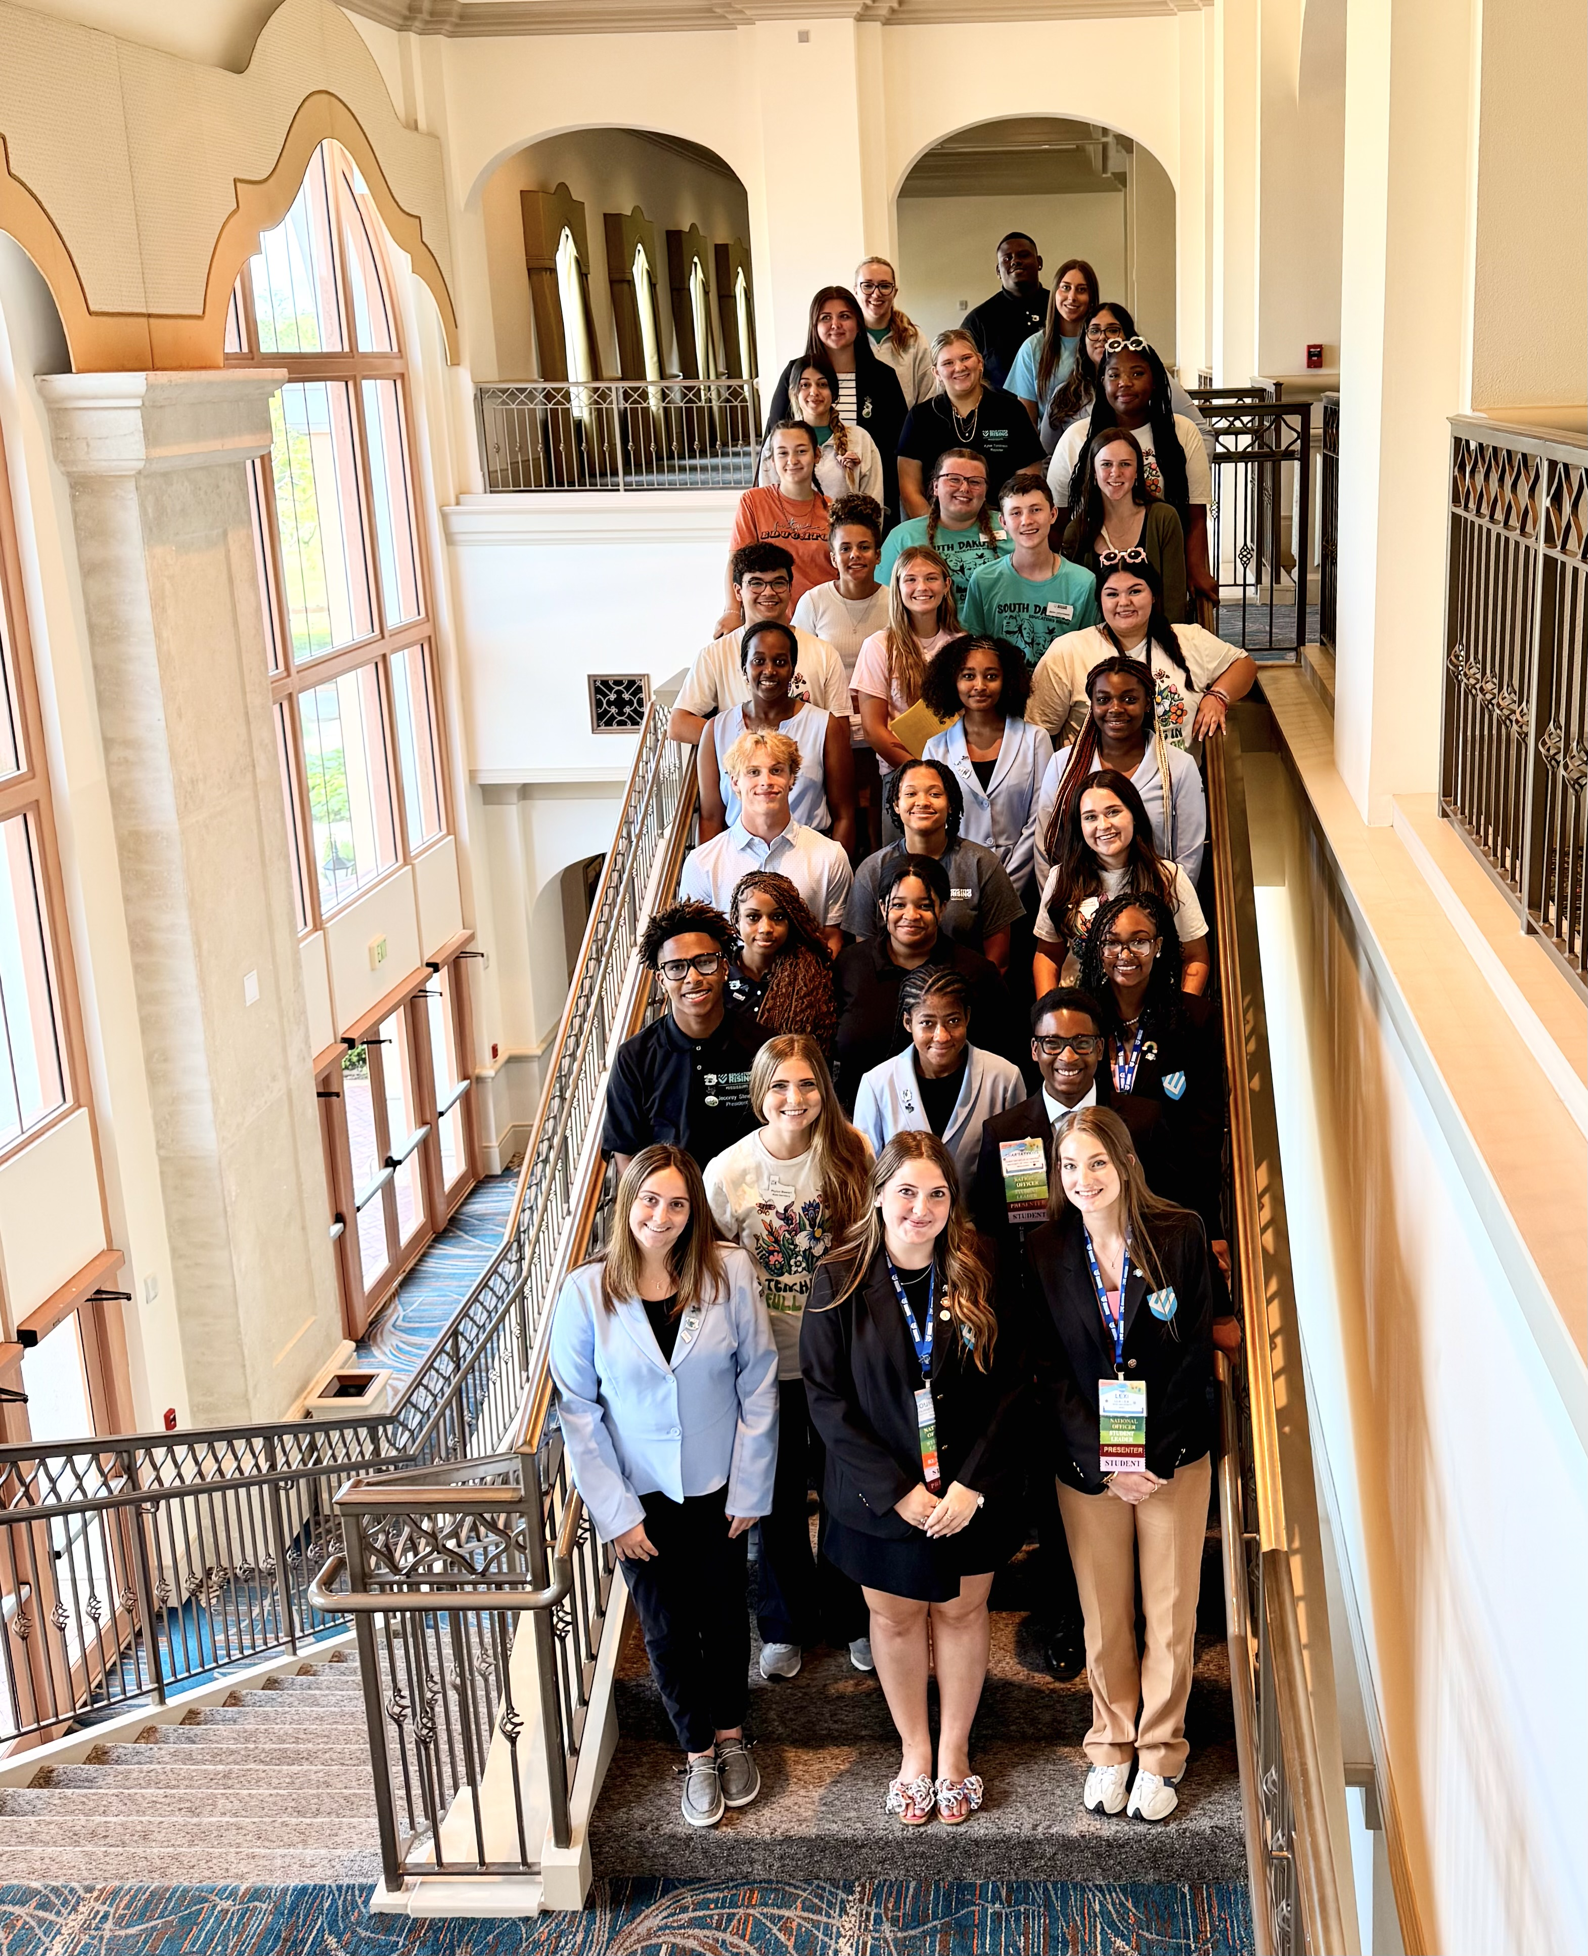
PDK Today
From 2023-2025, Dr. James Lane served as a our chief executive officer, setting strategic direction to expand our Educators Rising CTSO to address the national teacher shortage
In November, 2024, There’s Power in Teaching podcast launched
In Summer 2025, PDK Board launched national search for next CEO
In Summer 2025, Dr. John Ramos, Sr. serves as transitional chief executive
In 2025, PDK celebrates ten years of Educators Rising with congressional support in Washington, D.C. and hosts biggest yet EdRising Conference in Orlando

Slide 8
PDK Association
Founded upon the core values of research, service, and leadership
Committed to growing and connecting leaders in education
Members can join individually as at-large members, but have the opportunity to join their local PDK chapter
Part of the continuum of membership supports offered by PDK to current and aspiring educators

Slide 9

PDK Association

Slide 10
Membership Benefits
Kappan Magazine - intersection of research, policy, and practice
International study tours
Scholarships
PDK Book Club
Exclusive access to PDK Poll archives and publications
Discounted access to JSTOR
Discounted member insurance
Networking and Supports
Notes:
In 2024, we launched PDK Prestige — a free membership tier with online access to Kappan and networking events, for educators of distinction

Slide 11
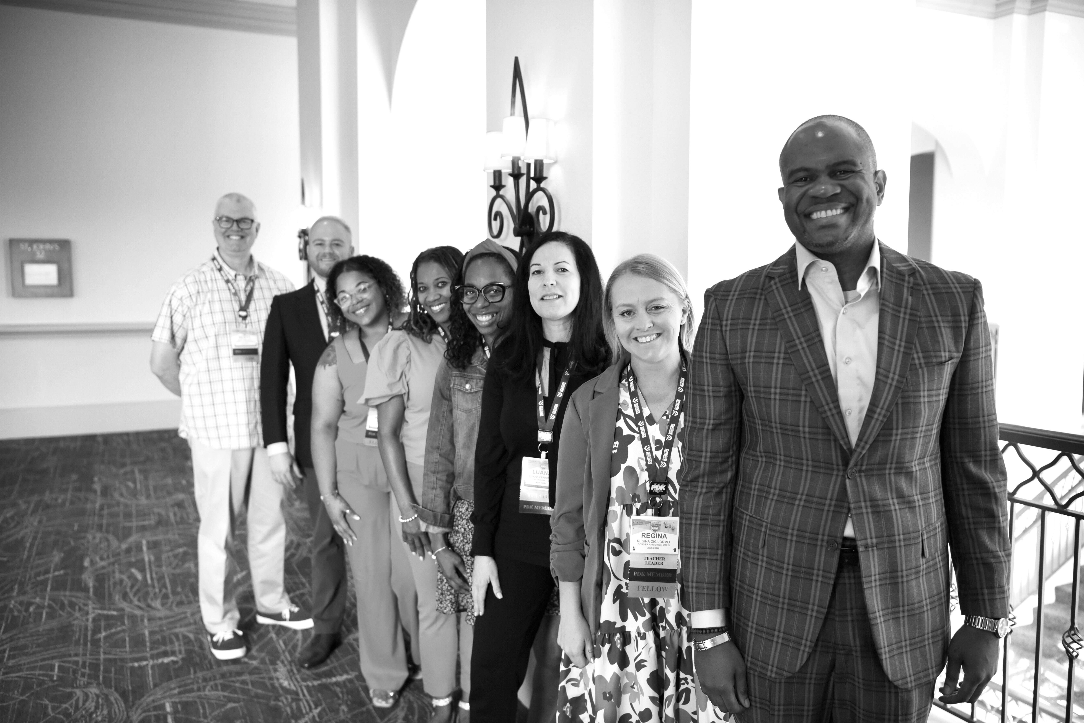
PDK Fellows Programs
PDK Emerging Leader Fellows
PDK Distinguished Educator Fellows
Notes:
www.pdkintl.org/distinguished

Slide 12
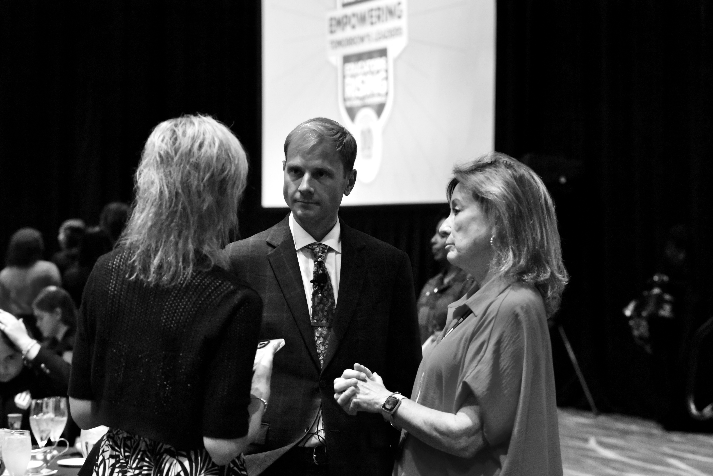
We are here to support you,
and the next generation.

Slide 13
PDK International
Arlington, Virginia
www.pdkintl.org

